Slide 1
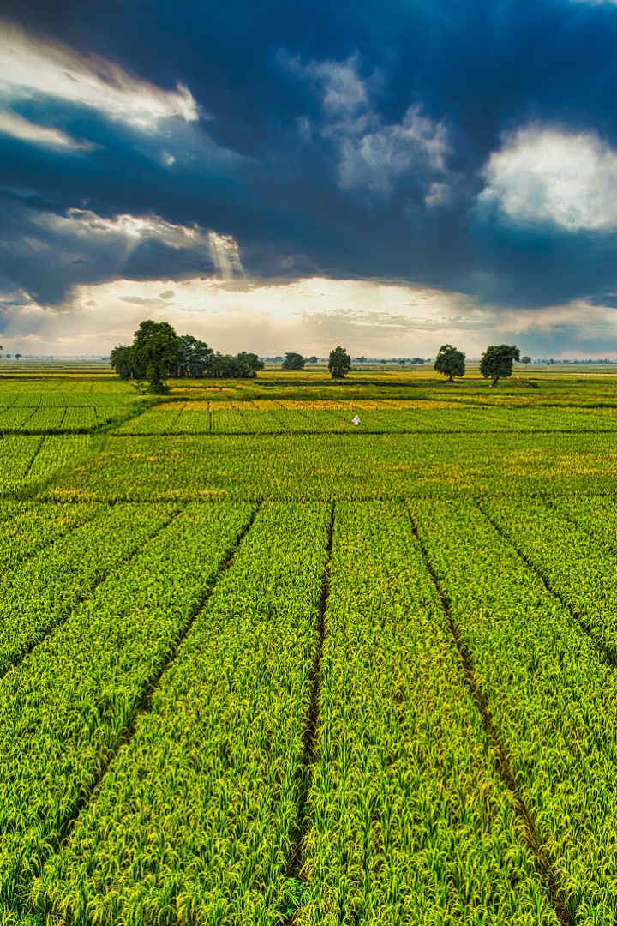


Krushi Manch: Empowering Farmers Through Digital Innovation
Krushi Manch is a digital platform revolutionizing agriculture in India, empowering farmers with the tools and resources they need to thrive.

Slide 2
Market Price Transparency: Real-Time Access to Latest Prices
Empowering Farmers
Fair Prices
Farmers can instantly access the latest market prices for their produce, allowing them to make informed decisions about when and where to sell.
Transparency in market prices helps to ensure fair prices for farmers, protecting them from exploitation and ensuring they receive a fair return on their hard work.

Slide 3

Direct Farmer-to-Buyer Connections: Streamlining the Supply Chain
Simplified Transactions
Efficient Sales
Farmers can connect directly with buyers, eliminating intermediaries and reducing costs, making their produce more accessible and affordable.
Krushi Manch provides a platform for farmers to showcase their produce, connect with potential buyers, and negotiate sales, leading to greater efficiency.

Slide 4



Agricultural Equipment Rental: Improving Efficiency and Productivity
Reduced Costs
Enhanced Productivity
Farmers can rent agricultural equipment like tractors, harvesters, and tillers, eliminating the need for expensive upfront purchases.
Access to modern equipment empowers farmers to work more efficiently, increasing their productivity and yields.

Slide 5
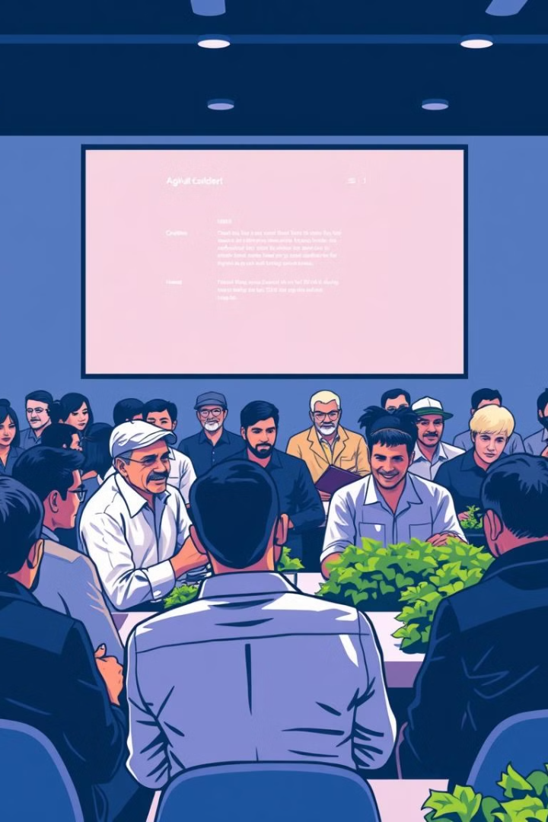
Farmer Support Services: Providing Valuable Resources and Guidance
1
Expert Advice
Krushi Manch offers access to expert advice from agricultural specialists, providing farmers with guidance on best practices and crop management.
2
Knowledge Sharing
Farmers can connect with other farmers to exchange knowledge, share experiences, and learn from each other's successes.
3
Market Updates
Krushi Manch provides real-time updates on market trends, weather conditions, and agricultural policies, enabling farmers to stay informed.

Slide 6
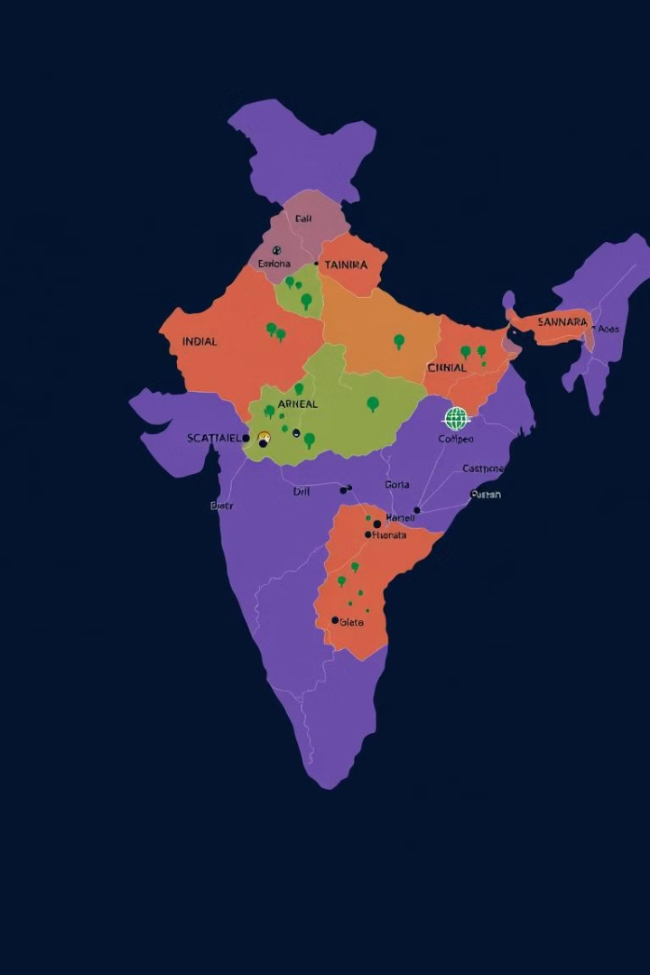


Expanding Reach: Connecting Rural Communities to Wider Markets
Broader Market Access
Farmers can connect with buyers across the country, expanding their market reach and finding new opportunities for their produce.
Increased Demand
Krushi Manch creates a wider demand for farmers' produce, ensuring that they can sell their crops at profitable prices.

Slide 7
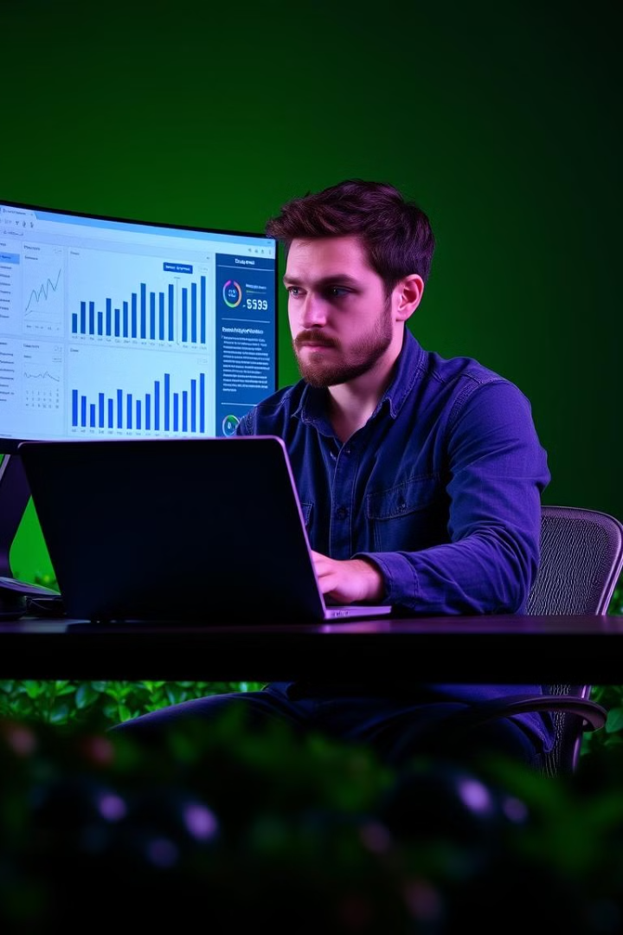
Data-Driven Insights: Informing Farmers' Decision-Making
100%
20%
Yield Optimization
Improved Profits
Farmers can use data to optimize their yields, identifying patterns in weather, soil conditions, and crop performance.
Data-driven decision-making empowers farmers to make more informed choices, leading to increased profits and financial security.

Slide 8
Thank You

